Slide 1
ZFS: Enterprise Storage for Everyone
Ben Kuhn - Supervisor of Network Services,
Rochester Public Schools

Slide 2
About me
Why should you listen to a network guy talk about storage?

Slide 3
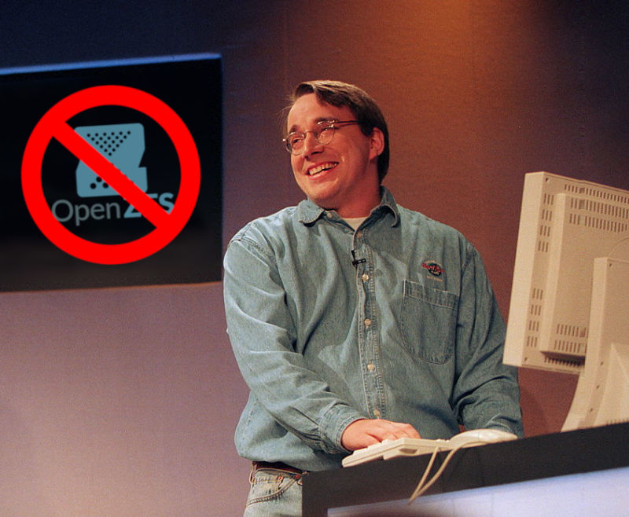
What is ZFS?
ZFS was always more of a buzzword than anything else
https://arstechnica.com/gadgets/2020/01/linus-torvalds-zfs-statements-arent-right-heres-the-straight-dope/

Slide 4
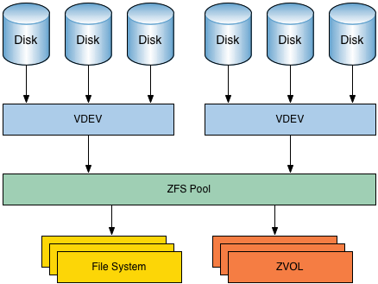
What is ZFS Really?
Image source: https://louwrentius.com/tag/zfs2.html

Slide 5
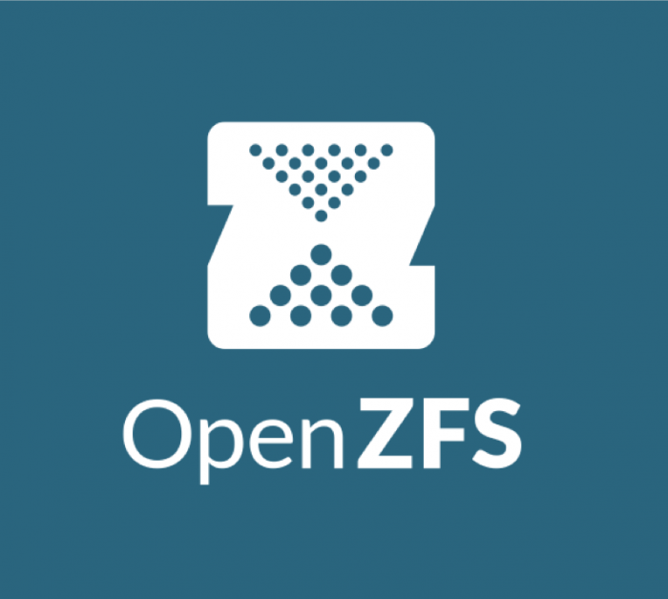
A Brief History of ZFS
ZFS development is started by 2 engineers at Sun Microsystems
Apple started porting ZFS to Mac OS X.
Apple’s ZFS development ends. MacZFS project begins.
OpenZFS project announced
First stable release of ZFS on Linux
2001
2007
2009
2013
2013
2005
2008
2010
2013
A port to FreeBSD was released as part of FreeBSD 7.0. A native Linux port is started
OpenSolaris discontinued. Code is forked and illumos project continues open ZFS development
Source code was released as part of OpenSolaris
OpenZFS on OS X Ports ZFS on Linux to OS X
http://open-zfs.org/wiki/History

Slide 6
ZFS Features
Online Pool Expansion
Data Checksums and Self-Healing
Compression
Deduplication
Quotas and Reservations
Thin-provisioning
Snapshots
Cloning
Replication
Virtual Block Devices
SSD Caching (storage tiering)

Slide 7
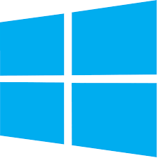
Supported Platforms

Slide 8
CDDL license issues with Linux

Slide 9
ZFS Misconceptions
Linus said not to use it
ZFS needs lots of RAM
ZFS requires expensive ECC Ram
ZFS isn’t fast
ZFS isn’t flexible
I need specific hard drives
You can’t add drives to a pool
For maximum performance, your number of drives limits VDEV types.

Slide 10
Design Considerations

Slide 11
When shouldn’t you use ZFS?
If you want to mix and match drive sizes *AND* need every free gigabyte of space
If you are adding or remove single drives on a regular basis and need redundancy
If you have less than 4GB ram in the system

Slide 12
Workload Considerations
IOPS, throughput, and latency

Slide 13
What is your workload?
Data Backup or file shares
Throughput more important than IOPS
Use RAIDZ(5) or RAIDZ2(6) level based on criticality of data
iSCSI Host for VM storage
Required IOPS based on number of VMs
Low latency is critical
Hopefully you have adequate backups
Use Striped Mirrors (RAID10) for best performance
Database server
IOPS are critical
Use Striped Mirrors (RAID10)
Consider SSD caching (more on this later)
Networked Video Recorder
Data is streamed so IOPS are minimal
Throughput is very important to minimize latency and prevent dropped frames
Consider striping over several RAIDZ or RAIDZ2 VDEVs

Slide 14
Calculating IOPS and Throughput: Stripes and Mirrors
N-wide striped:
Read IOPS: N * Read IOPS of a single drive
Write IOPS: N * Write IOPS of a single drive
Streaming read speed: N * Streaming read speed of a single drive
Streaming write speed: N * Streaming write speed of a single drive
Storage space efficiency: 100%
Fault tolerance: None!
N-way mirror:
Read IOPS: N * Read IOPS of a single drive
Write IOPS: Write IOPS of a single drive
Streaming read speed: N * Streaming read speed of a single drive
Streaming write speed: Streaming write speed of a single drive
Storage space efficiency: 50% for 2-way, 33% for 3-way, 25% for 4-way, etc. [(N-1)/N]
Fault tolerance: 1 disk per vdev for 2-way, 2 for 3-way, 3 for 4-way, etc. [N-1]
Use the specifications of your slowest drives in these formulas
https://www.ixsystems.com/blog/zfs-pool-performance-1

Slide 15
Calculating IOPS and Throughput: RAIDZ
N-wide RAIDZ, parity level p:
Read IOPS: Read IOPS of single drive
Write IOPS: Write IOPS of single drive
Streaming read speed: (N – p) * Streaming read speed of single drive
Streaming write speed: (N – p) * Streaming write speed of single drive
Storage space efficiency: (N – p)/N
Fault tolerance: 1 disk per vdev for Z1, 2 for Z2, 3 for Z3 [p]
Use the specifications of your slowest drives in these formulas
https://www.ixsystems.com/blog/zfs-pool-performance-2

Slide 16
Calculating IOPS and Throughput: Multiple VDEVS
More Complex setups
Multiple VDEVS can be added in to a pool (RAID10, RAID50, etc…)
Read IOPS: N * Read IOPS of slowest VDEV
Write IOPS: N * Write IOPS of slowest VDEV
Streaming read speed: N * Streaming read speed of a slowest VDEV
Streaming write speed: N * Streaming write speed of a slowest VDEV
Fault tolerance: If one VDEV fails the pool is lost.
Use the specifications of your slowest drives in these formulas
https://www.ixsystems.com/blog/zfs-pool-performance-1

Slide 17
Special VDEVs
SLOG devices
Write Cache (Intent Log) device
MUST be faster than your disks
Useful for applications demanding synchronous writes (databases)
Data is moved from the SLOG to the pool in the background.
Use 2 for redundancy
L2ARC devices
Read Cache device
Lives between L1ARC in RAM and your disk pool
MUST be faster than your disks
Does not need to be redundant
FILO ring buffer for L1ARC
Does not persist between reboots
Might not be worth using (yet)

Slide 18
Creating a pool
# zpool create PoolName -o ashift=12 compression=lz4\
mirror /dev/sdb1 /dev/sdc1\
mirror /dev/sdd1 /dev/sde1
Use Partitions instead of full disks (full disks are supported, however).
Pay attention to disk block size. Force 4K blocks with ashift=12, 8K blocks (Samsung SSDs) with ashift=13.
This pool will mount at /PoolName. The mountpoint= flag will change this.
LZ4 compression is enabled. Only compressible blocks will be compressed.

Slide 19
Creating a filesystem
# zfs create PoolName/FSName
# zfs create -o compression=off PoolName/FSName/ChildFS
By default, options applied to the parent will be applied to child filesystems (pool options will apply to all filesystems in the pool)
Options can be overridden or changed on a per-filesystem basis
The first example will mount at /PoolName/FSName. The second mounts at /PoolName/FSName/ChildFS The mountpoint= flag will change this.
LZ4 compression is disabled on the second example.

Slide 20
Destroying Pools and Filesystems
# zfs destroy -r PoolName/FSName
# zpool destroy PoolName
Use the -r flag for a recursive destroy (including snapshots). The top example destroys PoolName/FSName/ChildFS from our previous example as well.

Slide 21
Demo 1 - Creating a Pool

Slide 22
Demo 2 - Growing a Pool

Slide 23
Demo 3 - Creating Filesystems

Slide 24
Demo 4 - Snapshot

Slide 25
Demo 5 - Replication

Slide 26
Demo 6 - Data Integrity and device replacement

Slide 27
Demo 7 - ZVOLs

Slide 28
Commercial Offerings and Support
iX Systems - TrueNAS and FreeNAS storage appliances. https://ixsystems.com
Canonical - ZFS is shipped with the Ubuntu distro. https://ubuntu.com
Proxmox - Proxmox Virtual Environment https://proxmox.com
Rsync.net - ZFS Replication to the cloud. https://rsync.net
Great Lakes SAN - Storage appliances and off-site backup. https://glsan.com
Oracle - ZFS Storage Appliance. https://www.oracle.com/storage/nas
Spectra Logic, Datto, and many others - http://open-zfs.org/wiki/Companies

Slide 29
Additional Resources
Techsnap Podcast - https://techsnap.systems
BSDNow Podcast - https://bsdnow.tv
OpenZFS Wiki - https://open-zfs.org/wiki/Main_Page
iX Systems Blog - https://www.ixsystems.com/blog
Jim Salter’s Blog - https://jrs-s.net/category/open-source/zfs/

Slide 30
Questions?

